Slide 1
DS: Stack, Queue, Tree & Binary Tree (incl. Space Complexity)
Session 05
Nikita Ananda Putri Masaling, S.Kom., M.Kom.

Slide 2
Learning Outcomes
Session 5
At the end of this session, students will be able to:
LO 1: Evaluate the time and space complexity of algorithms using asymptotic notation and formal analysis methods, and prove algorithm correctness using loop invariants, induction, or exchange arguments.
LO 2: Analyze unfamiliar computational problems by identifying their structural properties, classifying them into known algorithmic categories including graph, string, and combinatorial problems and recommending a solution strategy with justification.

Slide 3
Learning Outcomes
Session 5
By the end of this session, students will be able to:
Evaluate O(1) time and O(n) auxiliary space for stack and queue operations; analyze BST operation complexity as O(h), distinguishing O(log n) for balanced trees from O(n) for degenerate trees.
Select the appropriate data structure (stack, queue, BST, balanced BST) given access-pattern requirements; classify tree traversals (inorder, preorder, postorder) as DFS variants; recommend a Red-Black Tree or AVL Tree when O(log n) worst-case operations are required.

Slide 4
outline
Session 5
Stack and Queue: Operations, Implementations, Complexity
Space Complexity: Auxiliary vs. Total Space
Tree Terminology and Traversals
Binary Tree Properties and Operations
Time vs. Space Trade-off in Data Structure Selection

Slide 5
Stack and Queue
stack
A stack is a dynamic set with a LIFO (Last-In, First-Out) discipline (CLRS, p. 248).
Operations:
PUSH(S, x) — insert element x.
POP(S) — remove and return the most recently inserted element.
STACK-EMPTY(S) — return TRUE if the stack has no elements.

Slide 6
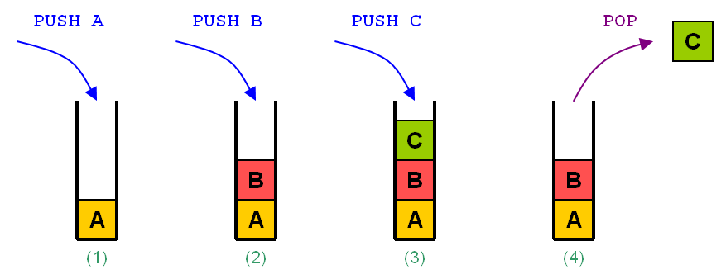
Stack analysis
definition
Rule of stack is LIFO (Last In First Out)
It only has TOP as the topmost element (for pushing and popping).

Slide 7
Stack and Queue
stack
Array implementation:
S.top = 0 (initially empty)
PUSH(S, x)
1 S.top = S.top + 1
2 S[S.top] = x
POP(S)
1 if STACK-EMPTY(S): error "underflow"
2 S.top = S.top - 1
3 return S[S.top + 1]

Slide 8
Stack and Queue
stack
Complexities (array, capacity n):
Linked-list implementation: each node holds data + pointer to next. PUSH/POP at the head. Same O(1) time per operation; total space O(k) where k = current number of elements (no wasted capacity).
Applications: function call stack, expression evaluation, DFS, undo operations, balanced parentheses checking.
Operation | Time | Space
PUSH | O(1) | -
POP | O(1) | -
PEEK | O(1) | -
Total space | - | O(n)

Slide 9
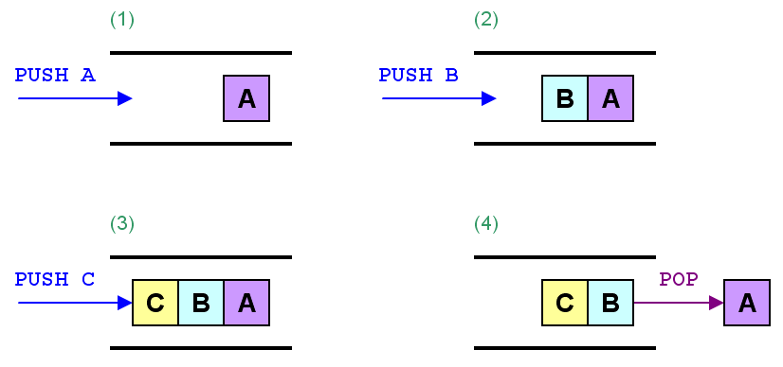
Stack and Queue
QUEUE
Rule of stack is FIFO (First In First Out)
It has FRONT (for popping) and REAR (for pushing).

Slide 10
Stack and Queue
QUEUE
With the knowledge about time complexity from last week, try to analyze the three operations of Queue! What is the worst-case time complexity for each operations?
  PUSH(x): Push a value into a queue (REAR).
  POP(): Pop the FRONT value of a queue
  EMPTY(): Empty the queue

Slide 11
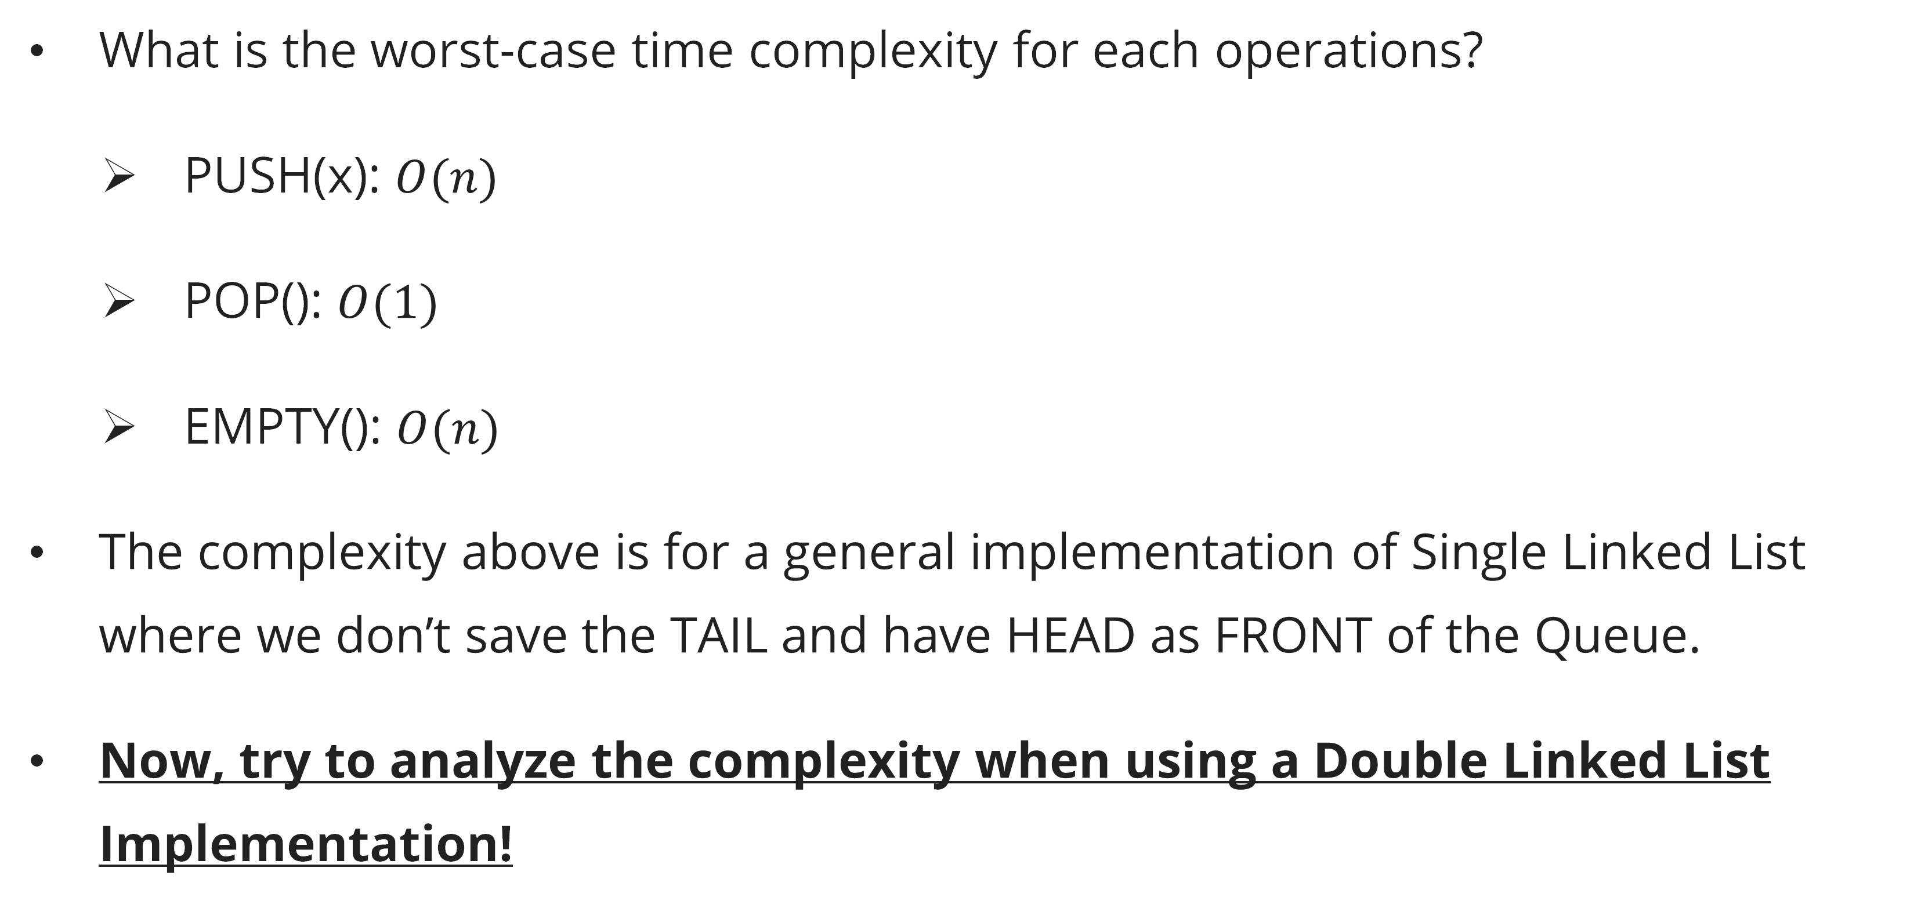
Stack and Queue
QUEUE
What is the worst-case time complexity for each operations?
  PUSH(x): $O(n)$
  POP(): $O(1)$
  EMPTY(): $O(n)$
The complexity above is for a general implementation of Single Linked List where we don’t save the TAIL and have HEAD as FRONT of the Queue.
Now, try to analyze the complexity when using a Double Linked List Implementation!

Slide 12
Space complexity
definitions
Auxiliary space: extra memory used by the algorithm beyond the input itself.
Total space: auxiliary space + input space.
In algorithm analysis, we usually report auxiliary space (the algorithm's own memory usage).

Slide 13
Space complexity
examples
Algorithm | Time | Auxiliary Space
Insertion Sort | O(n²) | O(1) — in-place
Merge Sort | O(n log n) | O(n) — merging requires a temporary array
Binary Search | O(n log n) avg | O(log n) — recursion stack
Quick Sort | O(log n) | O(1) iterative / O(log n) recursive
BFS on graph | O(V + E) | O(V) — queue + visited array
DFS on graph | O(V + E) | O(V) — stack / recursion

Slide 14
Space complexity
Stack space for recursion
A recursive algorithm uses O(depth) stack space. For a balanced recursion tree of depth log n (e.g., Merge Sort, Binary Search), this is O(log n). For a linear recursion (e.g., naïve Fibonacci, DFS on a path graph), this is O(n) — beware of stack overflow for large inputs.

Slide 15
Tree terminology and traversals
Basic terminology
A rooted tree T is a connected, acyclic undirected graph with a designated root r (CLRS, p. 265).
Key terms:
Node (vertex): each element of the tree.
Root: the topmost node (no parent).
Parent / Child: x is the parent of y if x is one level above y on the path from x to the root.
Leaf: a node with no children.
Internal node: a node with at least one child.
Depth of node x: length of the path from the root to x.
Height of tree: maximum depth of any node.
Subtree rooted at x: x and all its descendants.

Slide 16
Tree terminology and traversals
Tree traversals
For a tree where each node has a left child and a right child (binary tree):
Preorder (Root → Left → Right):
PREORDER(x)
1 if x ≠ NIL
2 print x.key
3 PREORDER(x.left)
4 PREORDER(x.right)

Slide 17
Tree terminology and traversals
Tree traversals
Inorder (Left → Root → Right):
Produces sorted output for a Binary Search Tree.
INORDER(x)
1 if x ≠ NIL
2 INORDER(x.left)
3 print x.key
4 INORDER(x.right)

Slide 18
Tree terminology and traversals
Tree traversals
Postorder (Left → Right → Root):
Useful for deleting trees, evaluating expression trees.
Time and space: all traversals visit each node exactly once → O(n) time; O(h) auxiliary stack space where h = height.
POSTORDER(x)
1 if x ≠ NIL
2 POSTORDER(x.left)
3 POSTORDER(x.right)
4 print x.key

Slide 19
Binary Tree Properties and Operations
Binary Tree Definition
A binary tree is a rooted tree where each node has at most two children, called left child and right child.
Properties:
A binary tree with n nodes has exactly n−1 edges.
A full binary tree has every node with 0 or 2 children.
A complete binary tree of depth d has all nodes at depths 0 through d−1, with depth-d nodes filled left to right.
A perfect binary tree of height h has exactly 2^(h+1)−1 nodes (all leaves at the same depth).
Height of a complete binary tree with n nodes: h = ⌊log₂ n⌋.

Slide 20
Binary Tree Properties and Operations
Binary Search Tree (BST)
A BST is a binary tree satisfying the BST property: for any node x, all keys in x's left subtree are ≤ x.key, and all keys in x's right subtree are ≥ x.key (CLRS, p. 312; Skiena, p. 81).
Operations on a BST with height h:
Operation | Time
SEARCH | O(h)
INSERT | O(h)
DELETE | O(h)
MIN / MAX | O(h)
SUCCESSOR | O(h)

Slide 21
Binary Tree Properties and Operations
Binary Search Tree (BST)
For a random BST with n distinct keys, the expected height is O(log n). In the worst case (already sorted input), height is O(n).
Search:
BST-SEARCH(x, k)
1 if x == NIL or k == x.key: return x
2 if k < x.key: return BST-SEARCH(x.left, k)
3 else: return BST-SEARCH(x.right, k)

Slide 22
Time vs. space trade-off
General principle
Algorithms often trade time for space or vice versa:
Memoization / caching: use extra space (O(n)) to avoid recomputation, reducing time from O(2ⁿ) to O(n) for Fibonacci.
In-place sorting: save space (O(1) auxiliary) at the cost of slower constant factors or more complex implementation.
Hash table: O(n) space for O(1) average lookup instead of O(log n) BST lookup.

Slide 23
Time vs. space trade-off
Data Structure Selection Guidelines
Note on "Balanced BST" (CLRS Ch. 13, p. 308): In this course, "Balanced BST" refers specifically to a Red-Black Tree (CLRS Ch. 13) or an AVL Tree. Both maintain height h = O(log n) by enforcing structural balance invariants after every insert/delete, guaranteeing O(log n) search, insert, and delete operations in the worst case. A plain BST without balance maintenance degenerates to O(n) height on sorted input.
Requirment | Preferred Stucture
LIFO acces | Stack
LIFO acces | Queue
Priority acces (max/min fisrt) | Heap (Session 6)
Ordered dynamic set | Balanced BST (Red-black Tree or AVL Tree) – see note below
Fast lookup by key | Hash table
Hierarchical data | Tree

Slide 24
Summary
Session 5
Stack: LIFO; push/pop in O(1); O(1) auxiliary space.
Queue: FIFO; enqueue/dequeue in O(1) with circular array.
Auxiliary space is the algorithm's additional memory beyond the input; recursion contributes O(depth) stack space.
Tree traversals (preorder, inorder, postorder) run in O(n) time and O(h) space.
BST operations run in O(h); for a balanced BST (Red-Black Tree or AVL) h = O(log n) guaranteed.
Choose data structures based on the required operations and the time-space budget.

Slide 25
Exercises
Session 5
Simulate PUSH and POP on a stack initialized to ⟨3, 2, 1⟩ (top = 3) with operations: PUSH(4), POP(), PUSH(5), POP(), POP(). What is the final state?
Draw the BST resulting from inserting the keys 5, 3, 7, 1, 4, 6, 8 in that order. Then write the inorder traversal — what property does it have?
A recursive DFS on a graph with n nodes and no back-edges (a tree) uses how much stack space in the worst case? In the best case?
Compare auxiliary space of iterative Merge Sort (using a temporary array) vs. iterative Bottom-Up Merge Sort (same algorithm, different framing). Are they different?
Explain why inserting n keys into a BST in sorted order gives a worst-case O(n²) total insertion time.

Slide 26
References
Session 5
Primary (Required):Cormen, T.H., Leiserson, C.E., Rivest, R.L., & Stein, C. (2022). Introduction to Algorithms, 4th Edition. MIT Press.
Ch. 10.1 — Simple Array-Based Data Structures: Arrays, Matrices, Stacks, Queues (p. 248)
Ch. 10.3 — Representing Rooted Trees (p. 265)
Ch. 13 — Red-Black Trees (p. 308) — balanced BST with O(log n) guaranteed operations
Secondary (Required):Skiena, S.S. (2020). The Algorithm Design Manual, 3rd Edition. Springer.
Ch. 3.1 — Contiguous vs. Linked Data Structures (p. 69)
Ch. 3.2 — Containers: Stacks and Queues (p. 75)
Ch. 3.4 — Binary Search Trees (p. 81)

